Slide 1
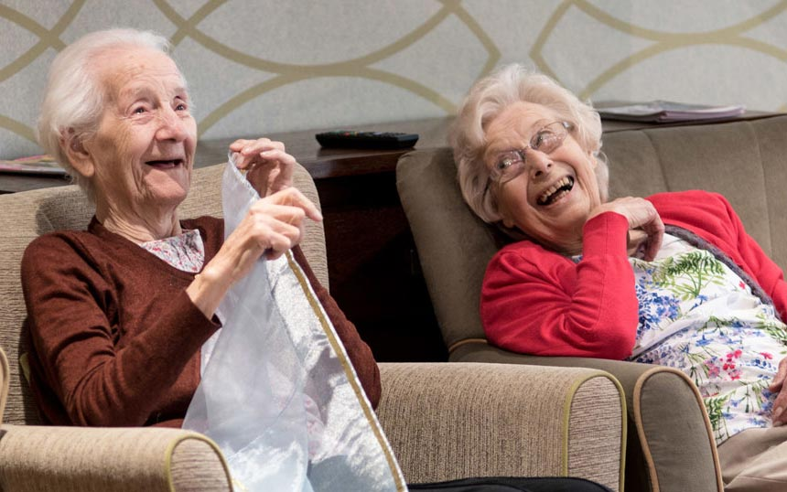
The @ Heart Project
Finding Joy In Their Journey

Slide 2
What a Great Memory Care Program Looks Like and Why it is Important to Senior Living Culture

Slide 3
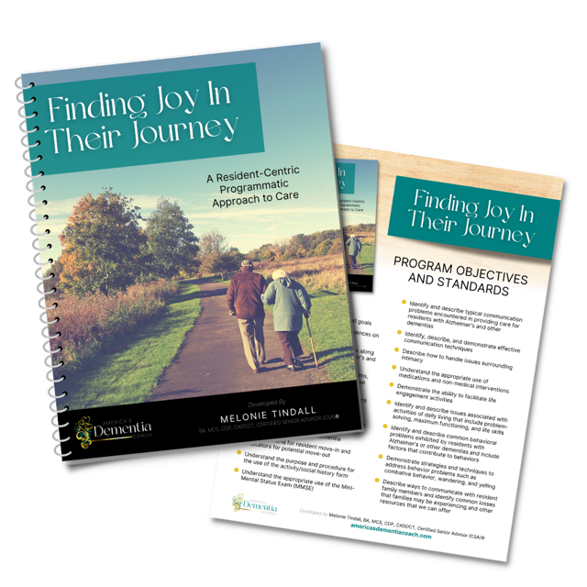
Finding Joy in Their Journey Training - focus on the Universal Worker concept and a holistic approach to address the needs of each resident and community team.
Premier Senior Services &
Consulting

Slide 4
Finding Joy In Their Journey
-
A resident-centric programmatic approach
Attain fundamental education on dementia and dementia care
Learn communication techniques
Foster sensitivity and respect for residents living with dementia
Implement sensitive approaches for assisting residents with activities of daily living
Improve the quality of life and quality of care of residents living with dementia

Slide 5
Finding Joy In Their Journey
Training Curriculum
Introduction to Dementia
QOL/QUAPI, Admissions/Move Outs, A Fresh Approach to Care
Communication, Aggressive Behaviors, Sexuality and Intimacy
Activities of Daily Living
Dining Experience, Snacks, Hydration
Life Engagement Activity Program, Best Engagement Solutions in the Marketplace, Authentic Living Skills Stations
Every Department and Discipline has a Role
Family Support and Involvement, Family Council, Family/Staff Interactions
Managing Stress in the Workplace

Slide 6
Have an in depth understanding of dementia
Identify common causes of aggressive, repetitive, and sundowning behaviors in adults
Describe behavioral/care interventions that may be used to prevent or reduce difficult care situations.
Describe challenges related to caregiver stress and utilize stress reduction techniques
Learn alternative activity interventions that are success-oriented and failure-free
Training Deliverables

Slide 7
OPPORTUNITIES
1-year support
CMP application, project management & evaluation reports all done by ADC
GOALS
Enrich the quality of life of Skilled Nursing and Life Plan Community residents
Improve interactions between staff and the residents in their care
Project Opportunities & Goals

Slide 8
@ Heart Project Deliverables
Virtual training for your convenience
Program manual
Printable PDF workbook
Annual virtual refresher
Unlimited calls/zoom calls
Train the trainer updates

Slide 9
Why join
the
@ Heart
Project?
Residents - A better understanding of their needs, more sensitive and beneficial assistance, can reduce the use of antipsychotics
Staff - Empowerment, better interactions with residents in their care, less burnout, retention
Compliance - Quality of life-related regulations, improved survey results
Differentiation –better connections for residents and staff, championing the value of training and staff education, supporting your staff’s development

Slide 10
Questions?
Do the best you can until you know better. Then when you know better, do better. ~M. Angelou …by joining the @ Heart Project
Melonie Tindall
720.315.1039
Melonie@premierseniorservices.org

